Slide 1
Introduction to Programming in Python
Ezekiel Adebayo Ogundepo (@gbganalyst)

Slide 2
Data type conversion

Slide 3
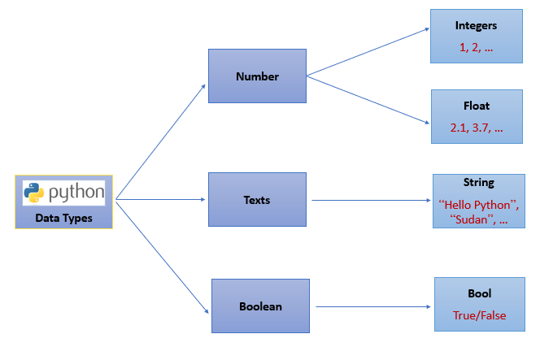
Data types

Slide 4
Data Type Conversions
Python allows us to convert objects from one data type to another. For example, you may need to convert a float to an integer (int). In programming this is called typecasting and has a lot of very many useful applications.
int()
float()
str()
bool()

Slide 5
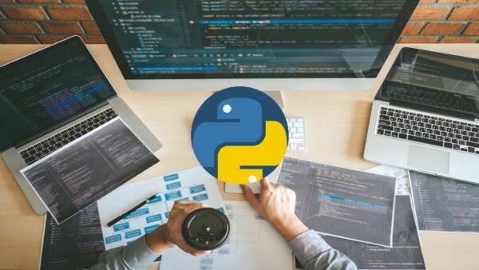
Lab session

